Slide 1
Manual Inputs - Flowcharts and Schematics
Data Analysis Architecture
20 February 2018

Slide 2
Agenda
Introduction
Folder structure
Etc.

Slide 3
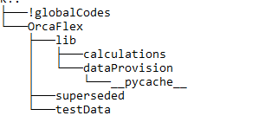
Folder Structure (GSY)
Explain the folder structure here? Example is below. Use tree command…
0119 Programming\009 PythonOrcaFlex\0119-009-SPM

Slide 4
Agile Development
Development
Data Provision
Calculations
Output
Visualizations

Slide 5
Overview
Data Provision : Provides data to the program
Calculations :
Perform required data transformations
Perform required analysis/calculations
Output:
Prepare output data to be written to database
Data visualization using templates
Data Provision
Calculations
Output
Visualizations

Slide 6
Temporary plan for Data Provision
Data provision from .xlsx
Output data will be saved to .xlsx
Visualizations will also be local (web in future).
.xlsx
Data Provision
DataFrames
Calculations
DataFrames
Future Plan
Databases
Databases

Slide 7
Temporary plan for Data Provision
Read riser data from Excel sheet(.xlsx format) / Database
function : riserProperties
riserStackUp function
Calculation of following riser properties:
Buoyancy Diameter
Inner diameter
Axial Stiffness
Bending Stiffness
Torsional Stiffness
Weight per unit length
Calculation of following riser Stackup lengths:
Riser component lengths
Defines number of flex joints
Flex Joint attached to riser at defined length
Water depth definition
Drill floor elevation
Riser boundary conditions
Internal fluid density
Element Length Control
Writes to text file or python file

Slide 8
Key Rules
Use Python for every task
Use dataframes to bring data from one to another
Utilize:
ONLY dataframe (df) for data to get in and out of calculations
Dataframe description and label (df_LU) for data description and data units
Standard codes as generic as possible. Re-use codes as much as possible

Slide 9
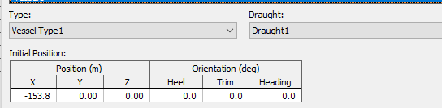
Vessel data
We need to extract vessel coordinates from excel/database or assign manually also.
We are assign vessel RAO’s and other tanker data from YML file (or python)
Sample code is placed in below.
import OrcFxAPI as orca # Its imports OrcaFlex.
model = orca.Model # Its opens OrcaFlex model
vessel = model.CreateObject (orca.otVessel, 'Tanker') # Its creates new vessel and gives its name
vessel.InitialX = 0 # its assigns vessel x position value and units are m
vessel.InitialY = 0 # It gives vessel Y position value and units are m
vessel.InitialZ = 0 # It gives vessel Z position value and units are m
vessel.InitialHeel = 0 # It gives vessel orientation value and units are deg.
vessel.InitialTrim = 0 # It gives vessel orientation value and units are deg.
vessel.InitialHeading = 0 # It gives vessel orientation value and units are deg.

Slide 10
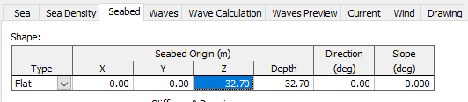

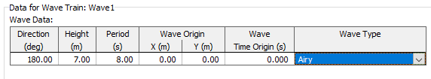
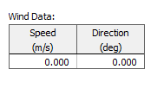
Environmental Data
Need to extract environmental data from excel.
Sample code is placed in below.
environment = model.environment
environment.Density = 1.025 # It gives water density value and units te/m^3
environment.WaterDepth = 32.7 # It assigns water depth and units are m
environment.WaveDirection = 130.0 # It assigns wave direction value and its units are deg.
environment.WaveHeight = 10 # It assigns wave height value and units are m
environment.WavePeriod = 6 # It assigns wave period value and units are seconds
environment.WaveType = ‘Airy' # It defines wave type
environment.RefCurrentSpeed = 10 # It defines current speed value and units are m/s
environment.RefCurrentDirection = 0 # It defines current direction and units are deg.
environment.WindSpeed = 20 # It defines wind speed value and units are m/s
environment.WindDirection = 0 # It defines wind direction and units are deg.

Slide 11
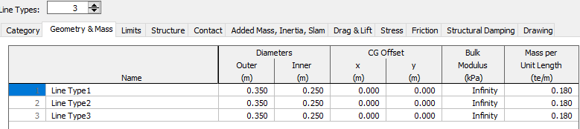
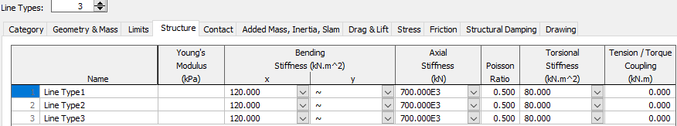
Line Type Data
Need to extract line type data from excel/database
We need to create more line types through looping based on number of line types required.
Sample code is placed in below. Repeat these code as per our requirement.
linetype = model.CreateObject(orca.otLineType, 'Hose') # It creates new line type and assign its name.
linetype.OD =0.6 # It gives Line Outer diameter and units are m
linetype.ID =0.4 # Line Inner diameter and units are m
linetype.MassPerUnitLength = 0.744 # Line type Mass per Unit length and units are te/m
linetype.EIx = 247609.05 # It assigns Bending Stiffness X value and units kN.m^2
linetype.EIy = 247609.05 # It assigns Bending Stiffness Y value and units kN.m^2
linetype.EA = 7566536.10 # It assigns Axial stiffness value and units are kN
linetype.PoissonRatio = 0.3 # Poisson ratio value
linetype.GJ = 190468.50 # It assigns Torsional stiffness value and units are kN.m^2

Slide 12
Rules
Data is taken as separately for units and values.
Use property and component names as per the OrcaFlex model.
We are reused the line type code and looping is required to this.

Slide 13
Function files
Calculating riser properties only by reading a simple spreadsheet
We need to write a function for competing this process

Slide 14
Function files
ORCAddVessel : Adds a new vessel
- ORCModifyVessel : modifies the properties of exsiting vessel
- ORCAddLine : Add new line
- ORCModifyLine : modifies properties of existing line or adds more length to it

Slide 15
THANK YOU
For the opportunity to serve

